Slide 1
Course : 0553T / Multimedia System
Year : 2015
MULTIMEDIA ADVANCED
Session 12

Slide 2
OUTLINE
Multimedia on the WEB
Mobile Multimedia

Slide 3
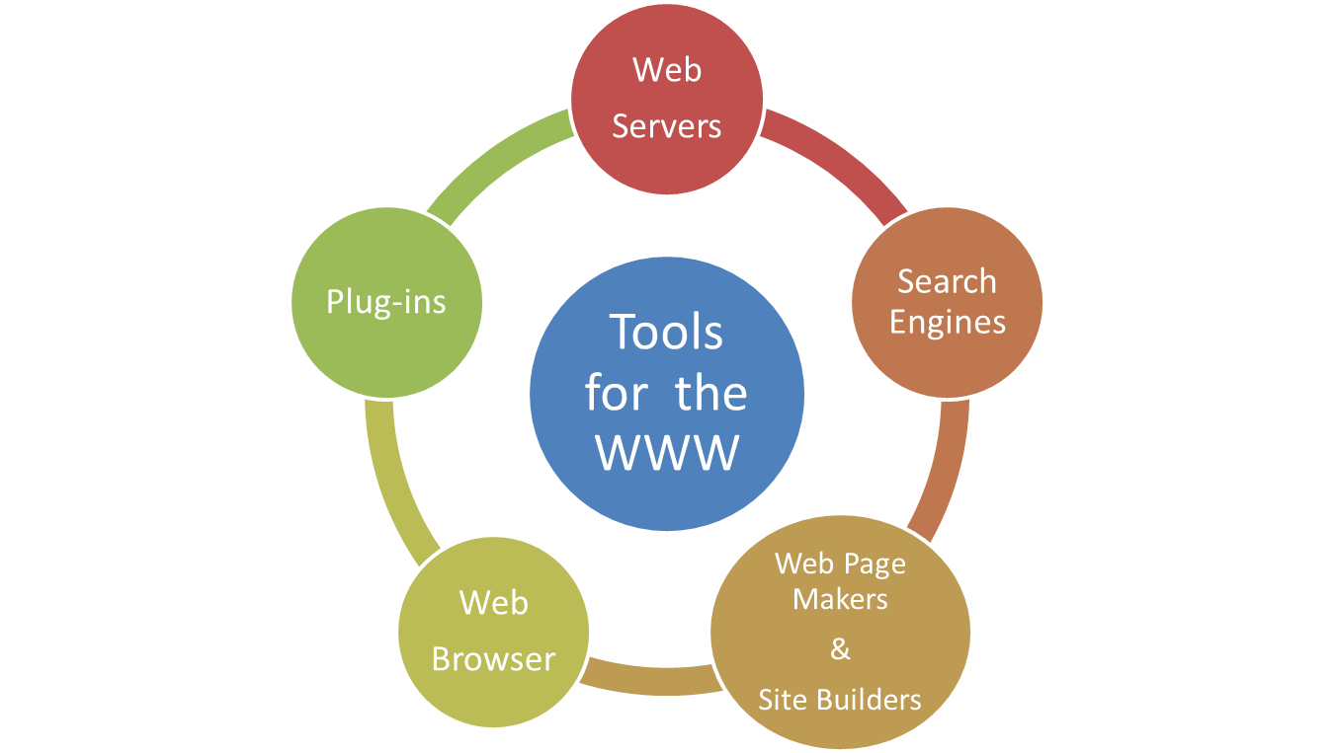
Multimedia on the WEB

Slide 4
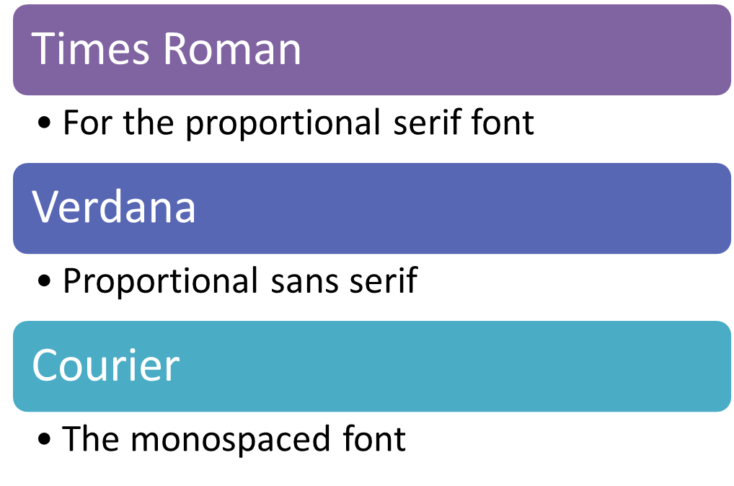
Multimedia on the WEB
Developing for the Web :
  Text for the Web

Slide 5
Multimedia on the WEB
Images for the Web
  GIF
  PNG
  JPEG
  SVG
For the web, line art is often better saved in GIF, PNG, or SVG than in JPEG.
Better using common format on web

Slide 6
Multimedia on the WEB
Video format on web(common format is better)
  .fla, .flv, .swf(Flash)
  .mpg, mpeg(MPEG-1)
  .asf (Advanced Streaming Format)
  .wmv (Windows Media Video)
  .mov (QuickTime)
  .avi (Audio/Visual Interleaved)
  .avi DivX
  .rm (Real Media)
For some reason, small size better than resolution

Slide 7
Multimedia on the WEB
Sound for the Web
  Most broswers allow embedding of sounds into documents using the <audio> tag.
  Inside the tag :
    Autoplay attribute
      Start the audio playing as soon as it is ready
    Controls attribute
      A play/pause control and other controls will be displayed
    Preload attribute
      The audio will load when the page does and be ready to run

Slide 8
Multimedia on the WEB
Animation for the Web
  HTML makes no provision for the animation
  Use JavaScript with XML features combined into Asynchronous JavaScript and XML (AJAX) for powerful interactive applications
  Adobe Flash Player plug-in for browsers offers animation and interaction.
  Canvas in HTML5 useful for creating interactive diagrams.
  Animated GIF (GIF89) can be used to make simple cell animations

Slide 9
Multimedia on the WEB
Video for the Web
  For standard method , HTML5 provides a <video> tag.
  Plug-ins and Player :
    Shockwave -> Macromedia
    LiveCode
    The QuickTime

Slide 10
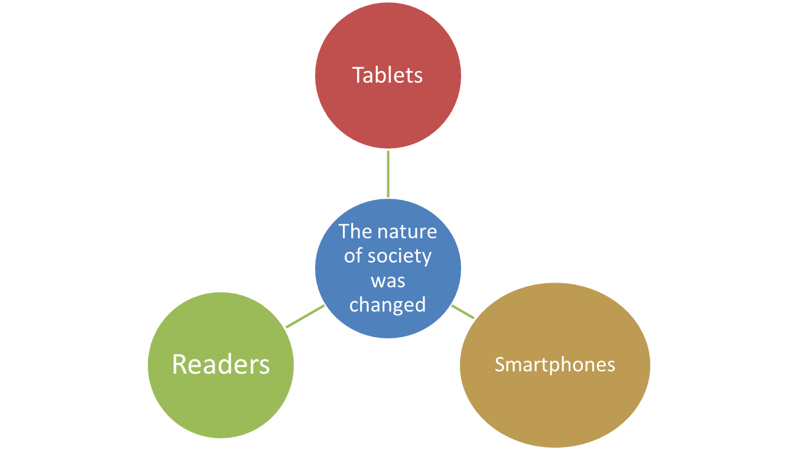
Mobile Multimedia

Slide 11
Mobile Multimedia
Mobile Hardware
  Becoming small
  Enables multi-touch gestures like pinches , swipes , and tap
The market
Vendor | Percent
Samsung | 25.7
Nokia | 13.8
Apple | 6.7
LG Electronics | 4.0
ZTE | 3.0
Huawei | 3.0
Vendor | Percent
Lenovo | 2.9
TCL Communication | 4.0
Sony Mobile Communication | 2.1
Yulong | 1.9
Others | 34.2

Slide 12
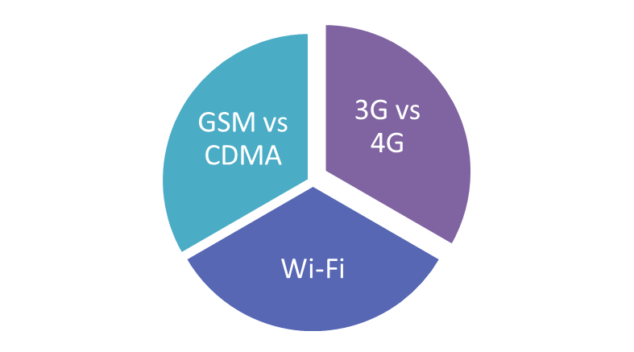
Mobile Multimedia
Connection
  Begins with a “handshake” ( a set of complicated but standardized protocols that allows the device and the radio to which it is connecting to identify and authenticate each other.

Slide 13
Mobile Multimedia
Mobile Operating System
  iOS vs Android
Codename(Version), API Level | Distribution, February 2014 | Release Date
Froyo(2,2), 8 | 1.3% | May,2010
Gingerbread (2.3.3-2.3.7) | 20% | December, 2010
Honeycomb (3.2), 13 (tablet only) | 0.1% | February,2011
Ice Cream Sandwich (4.0.3-4.0.4),15 | 16.1% | October ,2011
JellyBean (4.10- 4.3) , 16-18 | 60.7 % | July, 2012
Kitkat (4.4), 19 | 1.8 % | September,2013
API, Distribution, and Release for Android Versions

Slide 14
Mobile Multimedia
Version , Distribution, and Release Date for iOS
Version | Highest Version for | Distribution, February 2014 | Release Date
3.1.3 | iPhone 1st iPod 1st | 4 % | February,2010
4.2.1 | iPhone 3G, iPod touch ( 2nd) |  | November,2010
5.1.1 | iPod touch ( 3rd) iPad ( 1st) |  | May, 2012
6.1.3 | iPhone 3GS | 22 % | March, 2013
6.1.5 | iPod touch ( 4^{th()} |  | November, 2013
7.0.4 | iPhone 4,iPhone 4S, iPhone 5, iPhone 5C, iPhone 5S, iPod touch, iPad2, ipad 3rd, iPad 4th , iPad Air, iPad mini 1st and 2nd | 74% | November,2013
7.0.5 | iPhone 5C and iPhone 5S ( China & selected European/ Asia Pacific models) |  | January,2014

Slide 15
Mobile Multimedia
Programming Mobile Apps
  Tools :
    Objective C -> iOS
    Java -> Android
    HTML5, CSS, JavaScript -> hybrid apps
  Methods :
    Responsive Web Design (RWD)

Slide 16
Supporting Materials
http://calafia.com/classroom/multi.htm
https://www.khronos.org/assets/uploads/developers/library/whitepaper_multimedia_mobile_phones.pdf

Slide 17
Exercise
Determined which graphic formats are best suited
Explain the kind of multimedia application that can be developed in mobile!

